Slide 1
Pathways in Technology Early College High School
P-TECHS - RESET
College, Career Readiness and Innovation
September and October, 2022
Jason Long
Executive Director, Secondary Schools

Slide 2
Agenda
Introductions
Review Blueprint
Review OBMS
EPISD Design
Lead Teacher Position
Designation Application
Next Steps?

Slide 3
PTECH Blueprint

Slide 4
Pathways in Technology (PTECH) (9-14) is an innovative program that guides students from a high school diploma through an Associate Degree and/or certification program to a fulfilling career.
The school must comply with the following TEA PTECH Blueprint consisting of 6 benchmarks to be designated a PTECH campus:
Benchmark 1: School Design
Benchmark 2: Target Population
Benchmark 3: Strategic Alliances
Benchmark 4: Curriculum, Instruction and Assessment
Benchmark 5: Work-Based Learning
Benchmark 6: Student Support

Slide 5
Benchmark 1: School Design The PTECH program must offer open enrollment and flexible scheduling structures that enable students to combine high school, postsecondary courses and work-based learning, at no cost to participating students.
Location (Options): stand alone, school within a school, or college campus
Staff:
Building administrator(s) (scheduling, hiring, and budgeting authority)
Industry/Business partner liaison (decision making authority)
Institute of Higher Education (IHE) liaison (decision making authority)
Highly Qualified P-tech teachers
Counseling Staff
Leadership team:
Identify team members and roles
District Leaders (superintendent, assistant superintendent, principal, CTE director)
Business/Industry Partners (CEO/president, community outreach specialist)
Institution of Higher Education Partners (college president, provost, P-Tech liaison)
Share responsibility
Monitor progress – TEA Blueprint requirements
Adjust/correct midcourse as needed
Create sustainable structures

Slide 6
Benchmark 1: School Design
The PTECH program must offer open enrollment and flexible scheduling structures that enable students to combine high school, postsecondary courses and work-based learning, at no cost to participating students.
Staff Development Plan: teachers and staff
Flexible student scheduling:
High school diploma
Industry certifications
Associate degree
Work-based learning
No cost

Slide 7
Benchmark 2: Target Population The PTECH program shall serve, or include plans to scale up to serve, students in Grades 9 through 14, and shall target and enroll students who are at risk of dropping out of school as defined by the Public Education Information Management System (PEIMS) and who might not otherwise go to college.
Open enrollment for All students
Identify, recruit and enroll subpopulations that are historically underrepresented in college
Document/report recruitment and enrollment policies
Establish transparent recruitment/enrollment process
Utilize weighted lottery system that favors students that are historically underrepresented in college

Slide 8
Benchmark 3: Strategic Alliances Strategic partnerships with business/industry partners and IHEs are formally articulated in writing and clearly define a variety of careers.
Develop memoranda of understanding (MOU) with Business/Industry:
Detailed plan by grade level for work-based learning experiences
Clear roles and responsibilities for business/industry partner personnel
MOU must include business/industry partner agreement for students to have priority in interviewing for any job in which the student is qualified upon completion of the program
Student access to business/industry partner facilities, services and resources

Slide 9
Benchmark 3: Strategic Alliances Strategic partnerships with business and industry partners and IHEs are formally articulated in writing and clearly define a variety of careers.
Execute an agreement with IHE that includes the following components:
Curriculum alignment
Instructional Materials
Course of study
Student enrollment and attendance
Grading periods and policies
Administration of statewide assessments
Policies for:
Advising students on the transferability of college credit
Ensuring the IHE transcript college credit earned through Dual Credit same semester as credit earned
Establish an Advisory Board who meets regularly and is composed of all stakeholders.

Slide 10
Benchmark 4: Curriculum, Instruction, and Assessment The PTECH program shall provide a rigorous course of study that enables a participating student to receive a high school diploma, an associate degree, postsecondary certificate provided by an IHE, or industry certification during Grades 9-14.
Work with local workforce to determine a list of high demand occupations and create pathways.
Establish one or more career pathways, that include industry relevant courses.
Create opportunities for students to complete high school graduation requirements and either an associate degree, post-secondary certificate provide by an IHE, or Industry Certification by the end of the sixth year (grade 14)
Measure student progress through an assessment process
Implement a structured data review process to identify students' strengths/weaknesses to provide individual student support
Provide support for students to obtain industry certifications/licenses

Slide 11
Benchmark 5: Work-Based Learning The PTECH program must offer students a variety of relevant, high-skill work-based learning experiences at every grade level that respond to student interest and regional employer needs and contribute to students earning aligned industry certifications and credentials.
Collaborate with local workforce development agencies to define local workforce needs
The PTECH shall provide:
Age level appropriate work-based learning that includes career awareness, career exploration, career preparation, and career experience
Extracurricular activities
Opportunities for career-building skills through job shadowing, internships, mentoring and apprenticeships

Slide 12
Benchmark 6: Student Support PTECH will provide wrap-around strategies and services involving multiple stakeholders (parents, teachers, counselors, community members, etc.) to strengthen both the academic and technical skills necessary for high school and college readiness, as well as provide academic, technical, and individual support for students to be successful in rigorous academic and work-based learning experiences.
Personalized Learning Environment:
Develop individualized, college and career focused student plan
Provide advisory and/or college readiness and support built into the program of study.
Provide bridge programs
Establish an industry mentorship program
Social and Emotional supports:
Skill building instruction for students (time management, study skills, and relationship skills)
Connect to social services as needed

Slide 13
PTECH OBMS

Slide 17
PTECH EPISD Design and Status

Slide 18
PTECH Cooperative Zone System
FHS
M-TECH
CoHS
B-TECH
EHS
C-TECH
PTECH Key:
B – Business/Account.
C – Computer Sci.
M – Health/Medicine
T – Teaching/E. Childhood
*EC – Early College
(TMECHS, BECHS)
IHS
M-TECH
AnHS
T-TECH
TMECHS
CHS
C-TECH
NW Zone
NE Zone
CCTE
AHS
C-TECH
BECHS
BoHS
T-TECH
JHS
M-TECH
2021 COHORT
CORONADO
2022 COHORT
ANDRESS
EL PASO
FRANKLIN
JEFFERSON
AUSTIN
BOWIE
CHAPIN
IRVIN
South Zone

Slide 19
2020-21 PTECH Planning Year 1st Cohort 2021-22
Campus | Students: Cohort/Total | Degree Plan | Certification | Industry Partner
Coronado HS | 125/500 | Accounting, Business, Economics | Computerized Accounting Applications | EPISD
El Paso HS | 125/500 | Computer Science | CISCO Networking | EPISD
Franklin HS | 125/500 | Multidisciplinary Studies | EMT | UMC
Jefferson HS | 125/500 | Multidisciplinary Studies | EMT | UMC

Slide 20
2021-22 PTECH Planning Year 1st Cohort 2022-23
Campus | Students: Cohort/Total | Degree Plan | Certification | Industry Partner
Andress HS | 125/500 | Teaching | EC | EPISD
Austin HS | 125/500 | Computer Science | Cisco Networking | EPISD
Bowie HS | 125/500 | Teaching | EC | EPISD
Chapin HS | 125/500 | Computer Science | Cisco Networking | EPISD
Irvin HS | 125/500 | Multidisciplinary Studies | EMT (Tentative) | UMC

Slide 27
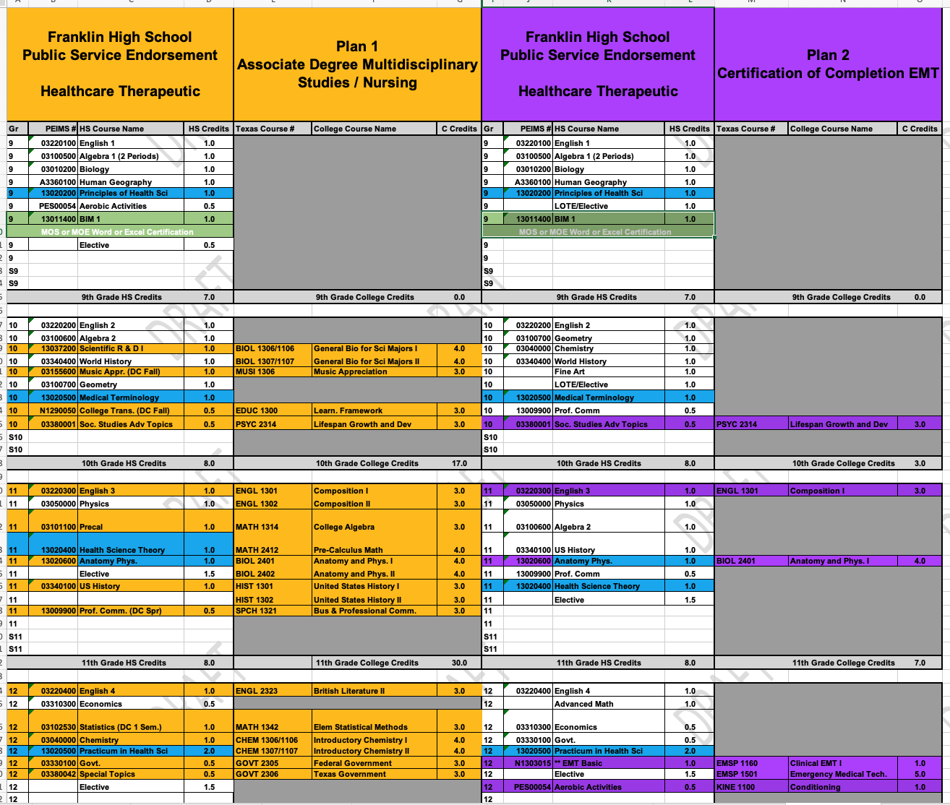

Slide 30
PTECH Lead Teacher – BIM 1

Slide 31
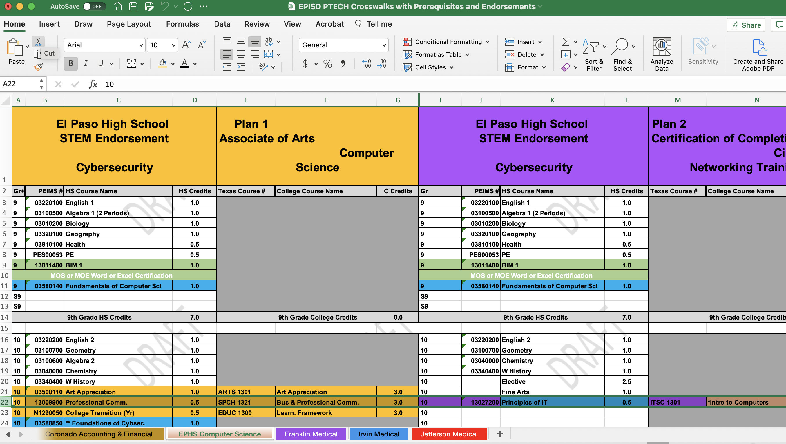
P-TECH Crosswalks

Slide 32
P-TECH Lead Teacher - BIM 1
Who?
Current Campus Teacher or New to Campus Teacher (In-District Only)
199-day contract (Teachers will have to interview for the position.)
*Campus CTE teachers MIGHT be relocated based on the outcome of the process.
*Likely NOT a new FTE.

Slide 33
P-TECH Lead Teacher - BIM 1
What?
The teacher will:
Teach 5 of 8 periods (1 coordination period) of BIM 1 (modified)
Teach non P-TECH CTE sections if the P-TECH cohort is small (less than 5 sections).
Assist campus staff with all P-TECH tasks such as:
Website Maintenance, Designation Application, Recruiting, Marketing, Work-Based Learning, TSIA2 Preparation & Testing, Degree Plan Audit Cards, Etc.
Serve as a liaison to EPPC and industry partner(s).
Prepare ALL P-TECH students for the Microsoft Office Expert in Word Certification Exam.

Slide 34
P-TECH Lead Teacher - BIM 1
When?
January to March 2022:
Interviews (with Principal/staff input)
April to June 2022:
Create Scope and Sequence with Advanced Academics/CTE
July 1, 2022:
Assigned to new position and/or campus (if applicable)

Slide 35
P-TECH Lead Teacher - BIM 1
Where?
All 9 P-TECH campuses.
*May expand idea to ALL students and campuses.
BIG help with CCMR – Industry Based Certifications. Word Certification Exam is $7.00.

Slide 36
P-TECH Lead Teacher - BIM 1
Why?
P-TECH requires a ‘corner stone’ class that all P-TECH students take as a foundation to the program for the establishment of culture. AVID like
The class will also be beneficial for students for TSIA2 prep, AA or Certification decision making, EPCC and Work Based Learning contacts/experiences.
There is P-TECH work before the official school year begins and after the school year ends (summer bridge and EPCC). Additional days on duty will allow the P-TECH lead teacher to assist with those duties.
P-TECH is A LOT of work. P-TECH is an Early College High School (School within a School) with an industry partner. Coordinators, APs (staff assigned) need help ASAP with website maintenance, designation application, recruiting, marketing, work-based learning, TSIA2 preparation & testing, degree plan audit cards. P-TECH assign staff can’t wait longer (year or more) for assistance.

Slide 37
PTECH Designation Application

Slide 38
Next Steps/Due Dates – October 21
Campus ‘to do’ list:
Complete Draft of Designation Application (PDF) with prefilled Assurance for Dr. Serrata (EPCC). Due to Mr. Long by October 21, 2022.
Submit prefilled Assurance Page to the Industry Partner by October 21, 2022.
Mr. Long’s ‘to do’ list:
Submit prefilled 9 Assurance Pages to Ms. Sayavedra by October 21, 2022.
Once ALL documents are approved, signed documents are returned to Mr. Long. Mr., Long will send to coordinators for FINAL SUBMISSION.

Slide 39
EPCC General Information
Designation Application Open
September 1, 2022 – December 16, 2022
EPISD Deadline: October 21, 2022
EPCC Deadline: November 1, 2022
PDF files to Tonie Badillo at mbadill4@epcc.edu.
Copy to Olaya Cazares at mcazare3@epcc.edu.

Slide 40
P-TECH Coding Reminder

Slide 42
Next Steps?
Additional Information?

